Slide 1
A MODEL FOR BUYERS FOR REAL ESTATE INVESTMENT IN LONDON

Slide 2
Why is it required?
London has experienced the most disrupted 10-year property cycle on record. In fact, Brexit uncertainty is merely a suffocating film coating this already complex and distorted sector.
Hidden price falls, record-low sales, Tax changes, Brexit uncertainty, higher house prices are making it increasingly harder for people to buy homes in the U.K. capital.

Slide 3
Goal
To provide support to homebuyers clientele in to purchase a suitable real estate in London in this uncertain economic and financial scenario.

Slide 4
Solution
Clustering London neighborhoods in order to recommend venues and the current average price of real estate where homebuyers can make a real estate investment.

Slide 5
Data and Methodology
Data: Data extracted from HM Land Registry which had shape (993670, 16) . Data was filtered by London City and Fields like street and price were taken to a data frame for further analysis.
Data was grouped by Street to get the average price street wise, and the resulting data frame filtered by applied price budget had shape of (143, 2) and data on amenities and essential facilities surrounding such properties from FourSquare API interface.
Mehodology:
Data Collection;
Explore and Understand Data;
Data preparation and preprocessing;
Modeling

Slide 6
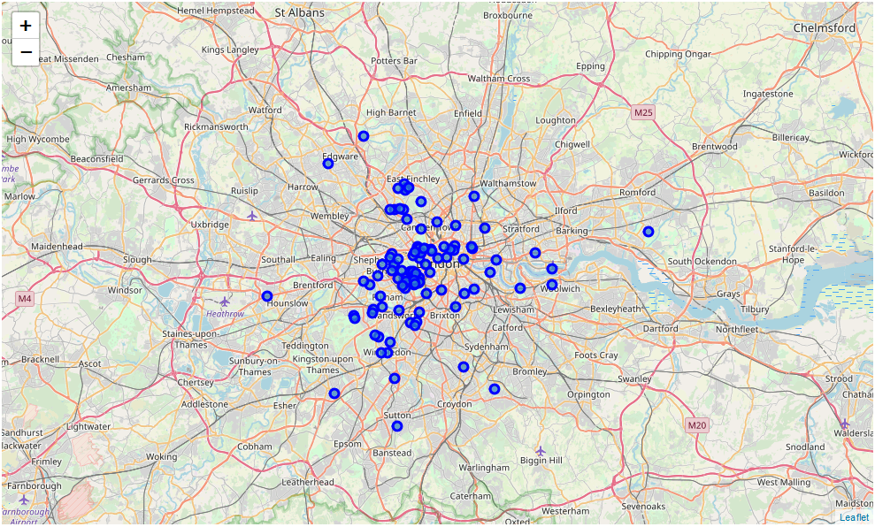
LONDON CITY STREET WISE WITH REAL ESTATE IN DEFINED BUDGET

Slide 7
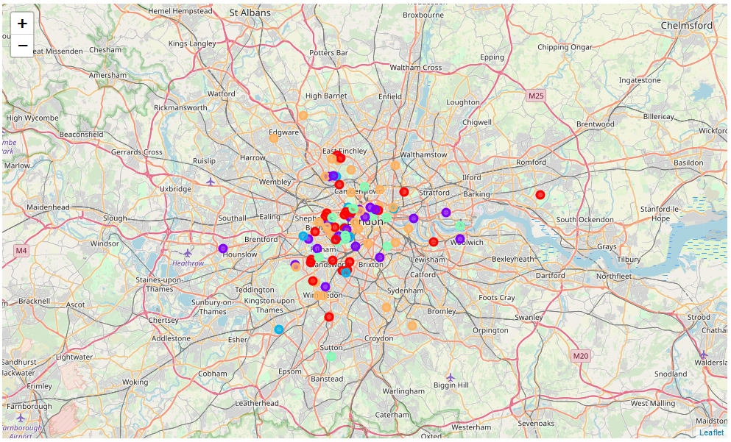
Clustering based on amenities

Slide 8
Conclusion and future direction:
Real estates examination according to neighborhoods/London areas
West London (Notting Hill, Kensington, Chelsea, Marylebone) and North-West London (Hampsted) might be considered highly profitable venues to purchase a real estate
Wandsworth, Balham and Isliington are arising as next future elite venues with a wide range of amenities and facilities.
Real estates examination by clusters
Clusters 0 may target buyers who wants the train station, sports club, pizza places nearby.
Clusters 2 and 4 may target home buyers prone to live near coffee shops, Pharmacy, theatres, Tennis court, restaurants;
Clusters 1 and 3 may target individuals who love pubs, theatres and soccer.

